Slide 1

Additions to the CO2 model: Movement & Parameters
Zijun Hu & Saif Rahman

Slide 2

Previous state of model
The original model had no movement
Many of the core settings in the model (e.g cell size, CO2 concentration etc.) were hardcoded, so any change required a recompilation and would be harder to change for an average user

Slide 3
The need for movement
The CO2 model assigns a type to each cell, this can be Air, CO2 Source, Impermeable Structure, Door, Window, Workstation or Vent.
Originally it would wait a set number of states(around 30), turn all workstations into CO2 sources and then after another number of states (around 250) it would turn them back into workstations
This works well but does not portray movement from the door to the station and back

Slide 4
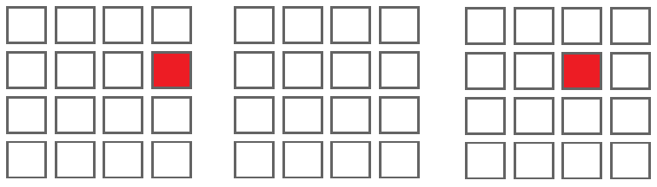
Idea behind the movement
By changing the current cell type and update the adjacent cell type, students can move.
Change the type of cell(3,2) to CO2_Source
Change the type of cell(3,2) to AIR
Change the type of cell(2,2) to CO2_Source
The decomposition of the students' movement

Slide 5

Implementation
Movement route:
Generate CO2 Source near the entry.
Start moving to the workstation.
Stay at workstation for a while.
Move to the exit and leave the room.

Slide 6
Support parameters and new functionalities
Support parameters:
studentsList: A list includes all CO2 sources that generated
workstationsList: A list includes all exist workstations
actionList: A list that records the future actions for CO2 sources movement
New functionality:
setNextRoute(): Calculate the next location for CO2 sources
navigation(): Integrate pedestrian behaviors[1] to avoid collisions
moveCheck(): Check if the next location is occupied
[1] A. Al-Habashna and G. Wainer, "Modeling pedestrian behavior with Cell-DEVS: theory and applications," SIMULATION, vol. 2, no. 92, pp. 117-139, 2016.

Slide 7
actionList
1. Cell(3,2) come in for local computation
Generate CO2 Source at cell(3,2)
Add the future action to the actionList
change cell(3,2)’s type to AIR
A list that records the future actions for CO2 sources movement
0
2. Cell(3,2) come in for local computation
Change cell(3,2)’s type to AIR
Remove this command from the actionList
Add the future action to the actionList
change cell(2,2) type to CO2 Source
0
By using the actionList, each cell only manage their own type.
It's simpler and easy to manage.
3. Cell(2,2) come in for local computation
Change cell(2,2)’s type to CO2 Source
Remove this command from the actionList
Add the future action to the actionList
change cell(2,2) type to AIR
0

Slide 8
Navigation
When the JSON is first read in, we store all the locations of the workstations
Each student generated is then assigned to a unique workstation
To model movement in the lab scenario more accurately we have made it so that students move along the y-axis first and then the x-axis

Slide 9
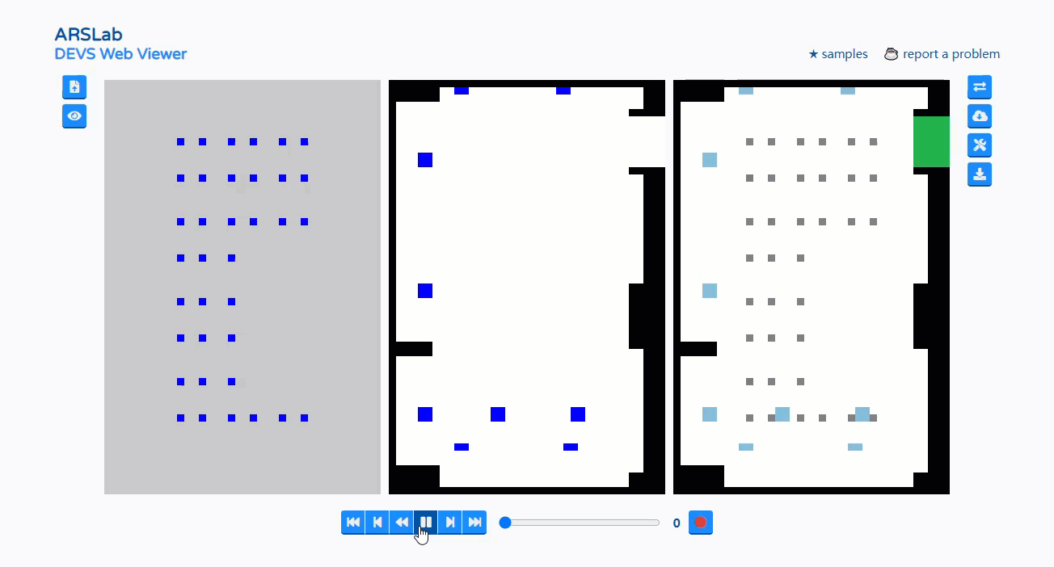
End result

Slide 10
Added parameters
All added parameters are in the json used to configure the model
Cell size: this is used to set the length, width and height for each cell, this in turn is used to calculate the volume in the model
CO2 concentration increase : this value can be changed to accommodate different co2 levels
start time: the step at which the non-movement model occupies the workstations
time active: the no. of steps the workstations remain occupied in the non-movement model

Slide 11
What’s next?
Further additions to parameterize the number of CO2 sources generated and the delay in between generation
Allow users to pick the spot where sources are generated and the exit point
Add walk through vent support in 2D model

